Slide 1
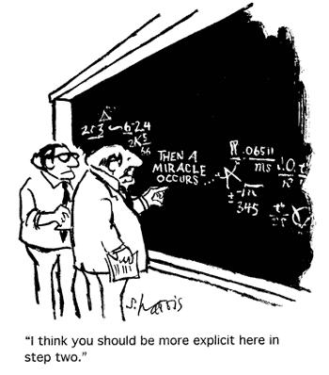
Proof of Correctness
for Dijkstra’s Algorithm

Slide 2
Warm up
Prove that the sum of a rational number and an irrational number is irrational.

Slide 3
Warm up
Proposition, P: The sum of a rational and irrational is irrational.
Assume, ¬P: The sum of a rational and irrational is irrational.
a/b + x = c/d , where a,b,c,d ∈ Z (integer), and x ∈ P (irrational)
x = c/d – a/b
x = (bc – ad) / (bd)
But this means x ∈ Q (rational)
So ¬P results in a contradiction.
QED

Slide 4
Dijkstra’s Algorithm
Let’s see how we can prove the correctness of Dijkstra’s algorithm by applying a proof by contradiction.

Slide 5
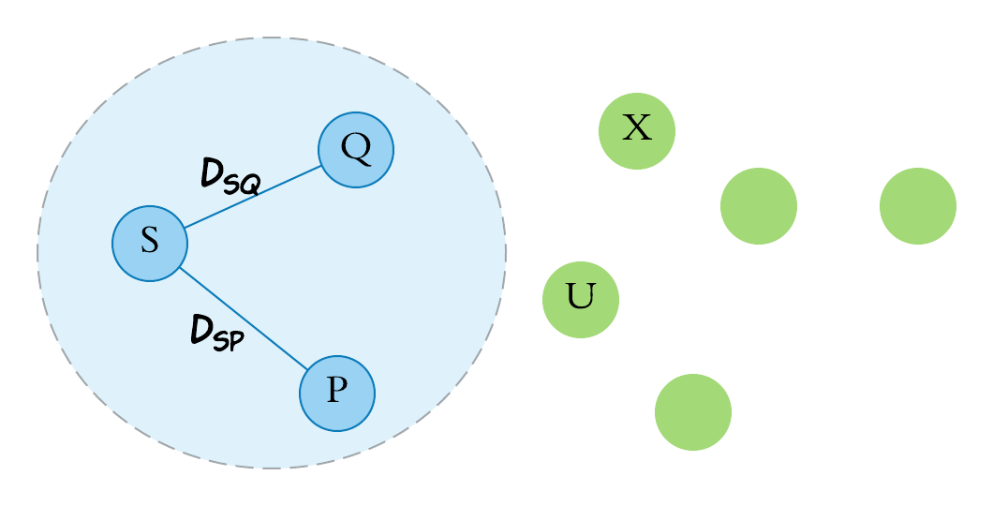
Dijkstra’s Algorithm
Let’s assume that Dijkstra’s has correctly determined the shortest distance to all the nodes in the region shaded below and locked these in..

Slide 6
Dijkstra’s Algorithm
Let’s assume that Dijkstra’s has correctly determined the shortest distance to all the nodes in the region shaded below and locked these in..
That is D_{SQ} is the minimum distance from S to Q and D_{SP} is the minimum distance from S to P

Slide 7
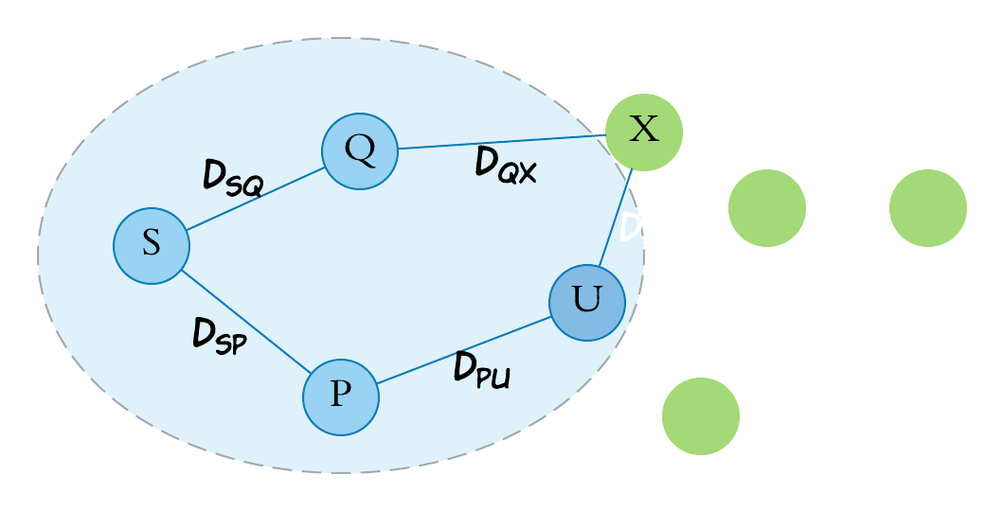
Dijkstra’s Algorithm
The Algorithm now wants to add U to the region, locking it in as the shortest distance from S to U.
Let us assume that this is a mistake and that the shortest distance to U is actually via the edge from Q to X and then from X to U

Slide 8
Dijkstra’s Algorithm
We know that D_{XU} > 0

Slide 9
Dijkstra’s Algorithm
We know that D_{XU} > 0
Therefore, as D_{SQ} + D_{QX} + D_{XU} < D_{SP} + D_{PU}
D_{SQ} + D_{QX} < D_{SP} + D_{PU}

Slide 10
Dijkstra’s Algorithm
But as Dijkstra’s chose to add U rather than X
We know that D_{SQ} + D_{QX} > D_{SP} + D_{PU}

Slide 11
Dijkstra’s Algorithm
This is contradictory (again) meaning that the shortest path was indeed the one chosen by Dijkstra’s Algorithm.

Slide 12
Dijkstra’s Algorithm
This is contradictory (again) meaning that the shortest path was indeed the one chosen by Dijkstra’s Algorithm.
CONTRADICTED!

Slide 13
Proposition, P:
An implementation of Dijkstra’s algorithm maintains a set of vertices called V, whose shortest known paths have been finalised.
Dijsktra’s algorithm will add node u to V via the edge (p, u) where p ∈ V, u ∉ V, and cost(s,…p,u) is the shortest known path
Assume, ¬P:
A shorter path to u exists via some other path: s,…,q,x,…,u, where q ∈ V, and x ∉ V.
When selecting a node to add, Dijkstra’s algorithm selects the node with the shortest known path.
As such, the cost(s,…p,u) ≤ cost(s,…,q,x)
Since weights in the graph are not negative, the cost(x,…,u) is ≥ 0.
But, cost(s,…p,u) ≤ cost(s,…,q,x) + cost(x,…,u), contradicting the original assumption and therefore showing that such a shorter path cannot exist.
QED
x
q
V
s
p
u

